Slide 1
Advisor : Jia-Ling, Koh Speaker : Ya-Fang, Hsiao Source : KDD ‘18 Date : 2018/11/13
Finding Similar Exercises
in Online Education Systems

Slide 2
1.
Introduction

Slide 3
Introduction
Finding Similar Exercise
For :
Practicing
Cognitive analysis of students
Online Education Systems
Such as :
KhanAcademy.org
Knewton.com
ASSISTments.org
Zhixue.com

Slide 4
Introduction
Similar Exercise
Those having the same purpose that is embedded in the semantics learned from exercise contents (i.e., texts, images and concepts)

Slide 5
Introduction
Challenges
How to integrate the multiple heterogeneous data?
How about the heterogeneous data associations?
How to measure the similar parts in each exercise pair?
MANN
novel Multimodal Attention-based Neural Network

Slide 6
2.
Framework

Slide 7
MANN Framework
Problem Definition
Details of MANN
MANN Learning
Formal definition of the FSE task
Introduce technical details of MANN framework
Specify a pairwise loss function to train MANN

Slide 8
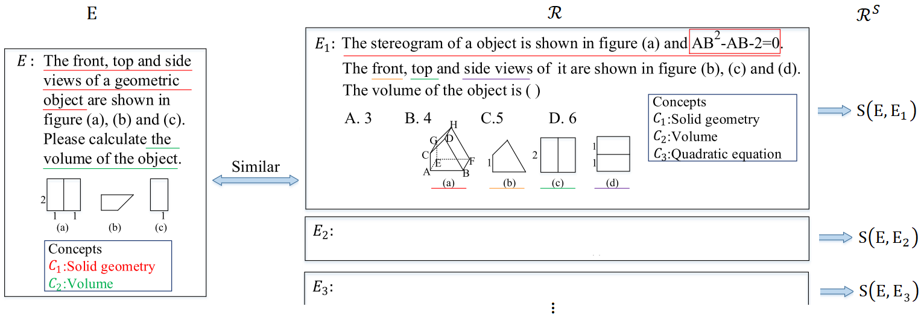
Problem Definition
$$ℱ\left(E,ℛ,Θ\right)→ℛ^{S}$$

Slide 9
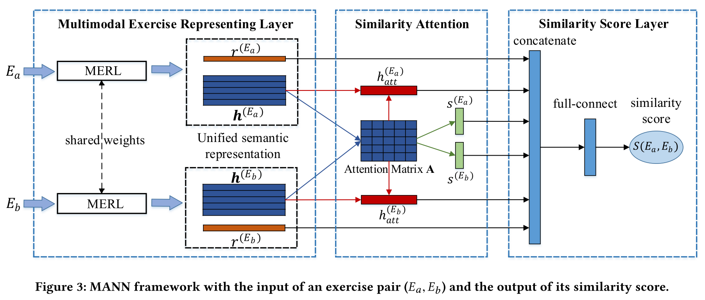
Details of MANN

Slide 10
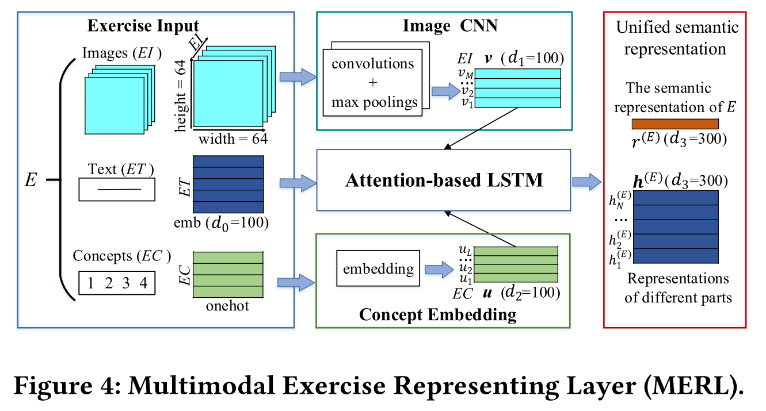
Multimodal Exercise Representing Layer

Slide 11
Multimodal Exercise Representing Layer
Exercise Text.
$ET=\left(w_{1},w_{2},…,w_{N}\right) ,$ $∈R^{d_{0}}$

Slide 12
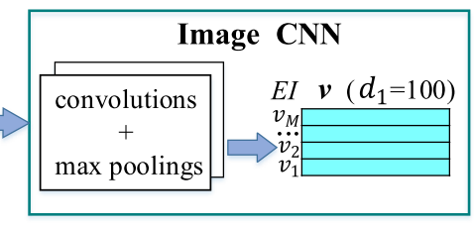
Multimodal Exercise Representing Layer
Exercise Image.
$EI=(p_{1},p_{2},…,p_{M})∈R^{M×64×64}$,
$p_{i}∈R^{64×64}$
$$ℒ_{ImCNN}=\sum_{p}{(DeImCNN\left(ImCNN\left(p\right)\right)−p)^{2}}$$
$$v_{i}=σ\left(ImCNN\left(p_{i}\right)\right),v_{i}∈R^{d_{1}}$$
$$EI→𝓋=(𝓋_{1},𝓋_{2},…,𝓋_{M})∈R^{M×d_{1}}$$

Slide 13
Multimodal Exercise Representing Layer
Exercise Concept.
$$EC=\left(k_{1},k_{2},…,k_{L}\right)∈{\left\{0,1\right\}}^{L×L_{all}}$$
$u_{i}=k_{i}W_{u}$, $W_{u}∈R^{L_{all}×d_{2}}$, $u_{i}∈R^{d_{2}}$
$$EC→𝓊=(𝓊_{1},𝓊_{2},…,𝓊_{L})∈R^{L×d_{2}}$$

Slide 14
Multimodal Exercise Representing Layer
Attention-based LSTM.
$$𝓍=\left(𝓍_{1},𝓍_{2},…,𝓍_{N}\right)$$
$$𝓍_{t}=w_{t}⨁{\hat{𝓊}}_{t}⨁{\hat{𝓋}}_{t}$$
Text-Concept Attention (TCA)
Text-Image Attention (TIA)

Slide 15
Multimodal Exercise Representing Layer
Attention-based LSTM.
TCA & TIA
$$𝓍_{t}=w_{t}⨁{\hat{𝓊}}_{t}⨁{\hat{𝓋}}_{t}$$
TCA :
$${\hat{𝓊}}_{t}=\sum_{j=1}^{L}{α_{j}𝓊_{j},}$$
$$α_{j}=\frac{φ(𝓊_{j},w_{t},h_{t−1})}{\sum_{i=1}^{L}{φ(𝓊_{i},w_{t},h_{t−1})}}$$
$$φ\left(𝓊_{j},w_{t},h_{t−1}\right)=V_{ac}tanh(W_{ac}[u_{j}⨁w_{t}⨁h_{t−1}])$$
TIA :
use $𝓋_{j}$、$V_{ai}$、$W_{ai}$ replace $𝓊_{j}$、$V_{ac}$、$W_{ac}$，

Slide 16
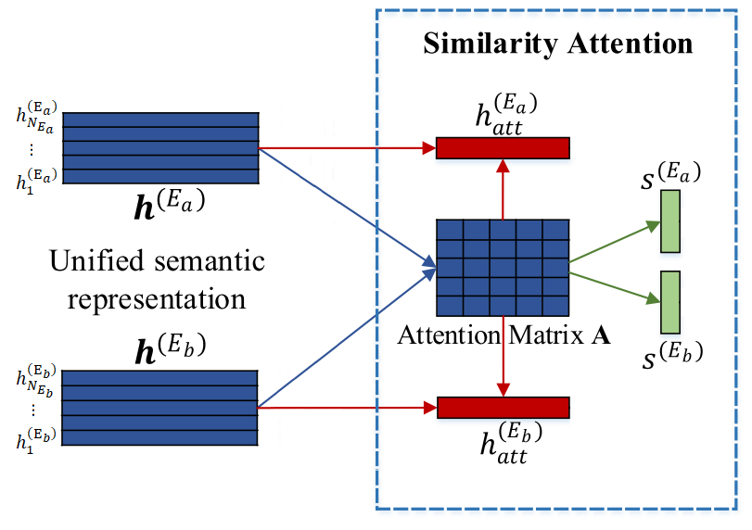
Similarity Attention
$A_{i,j}=cos\left(h_{i}^{\left(E_{a}\right)},h_{j}^{\left(E_{b}\right)}\right)$, $A∈R^{N_{E_{a}}×N_{E_{b}}}$
$s_{i}^{(E_{a})}=\sum_{k=1}^{N_{E_{b}}}{A_{i,k}}$,
$h_{att}^{\left(E_{a}\right)}=\sum_{i=1}^{N_{E_{a}}}{A_{i,N_{E_{b}}}h_{i}^{\left(E_{a}\right)}}$,
$$s_{j}^{(E_{b})}=\sum_{k=1}^{N_{E_{a}}}{A_{k,j}}$$
$$h_{att}^{\left(E_{b}\right)}=\sum_{i=1}^{N_{E_{b}}}{A_{N_{E_{a}},j}h_{j}^{\left(E_{b}\right)}}$$

Slide 17
Similarity Score Layer
$${\tilde{z}}_{ab}=r^{\left(E_{a}\right)}⨁r^{\left(E_{b}\right)}⨁s^{\left(E_{a}\right)}⨁s^{\left(E_{b}\right)}⨁h_{att}^{\left(E_{a}\right)}⨁h_{att}^{\left(E_{b}\right)}$$
Two full-connected networks :
${\tilde{o}}_{ab}=ReLU(W_{1}{\tilde{z}}_{ab}+b_{1})$
$S\left(E_{a},E_{b}\right)=σ(W_{2}{\tilde{o}}_{ab}+b_{2})$

Slide 18
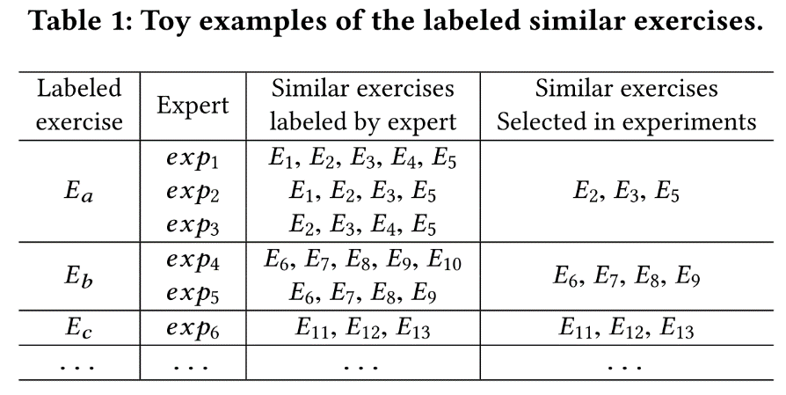
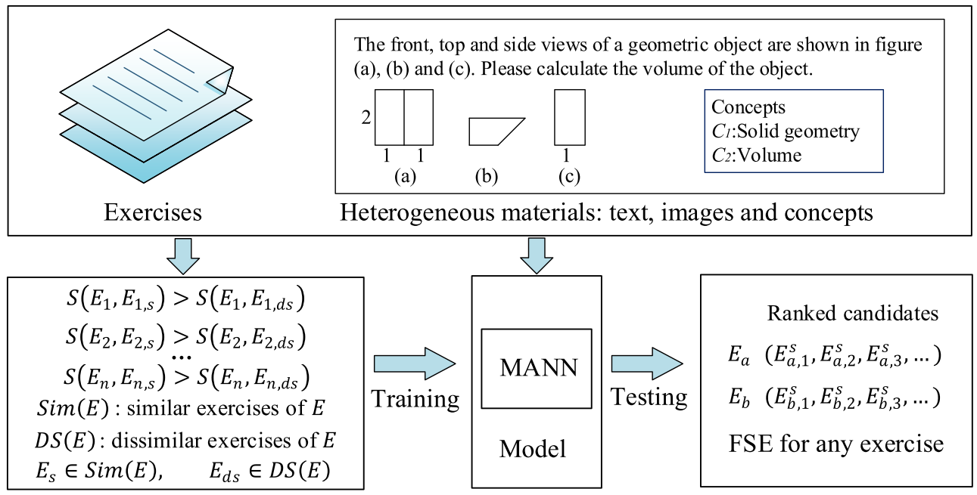
MANN Learning
$$Pairwise loss function :$$
$$E_{s}∈Sim\left(E\right), E_{ds}∈DS\left(E\right)$$
$$ℒ\left(Θ\right)=\sum_{E,E_{s},E_{ds}}{\max\left(0,μ−\left(S\left(E,E_{s}\right)−S\left(E,E_{ds}\right)\right)\right)}+λ_{Θ}|{\left|Θ\right||}^{2}$$
Dissimilar exercises sampling ways :
Sampling Randomly (Random).
Sampling by Concepts (Concept).

Slide 19
3.
Experiments

Slide 20
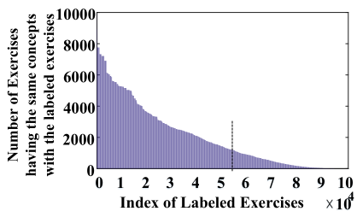
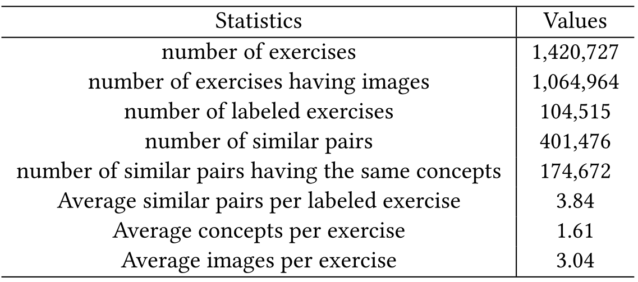
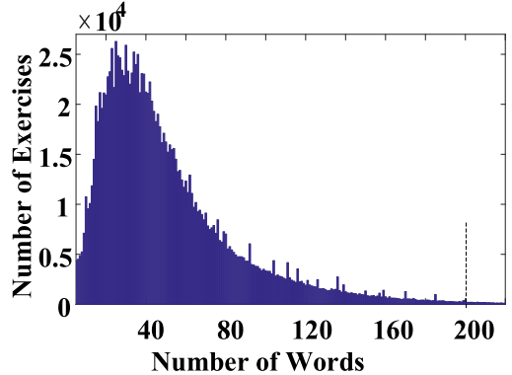
Experiments

Slide 21
Experiments
VSM : combining TF-IDF and cosine similarity
LSTM : learn the semantic similarity
m-CNN : multimodal CNN
ABCNN : modeling sentence pairs
MANN : multimodal attention-base
-T : Text
- I : Image
-C : Concept
-A : Attention

Slide 22
Experiments
Each model with different number(m) of
the sampled unlabeled exercises for each given exercise

Slide 23
Experiments
Random sample : E_{s} are very different from E_{ds}
Concept sample : Es are close to E_{ds} -> can focus on the subtle differences

Slide 24
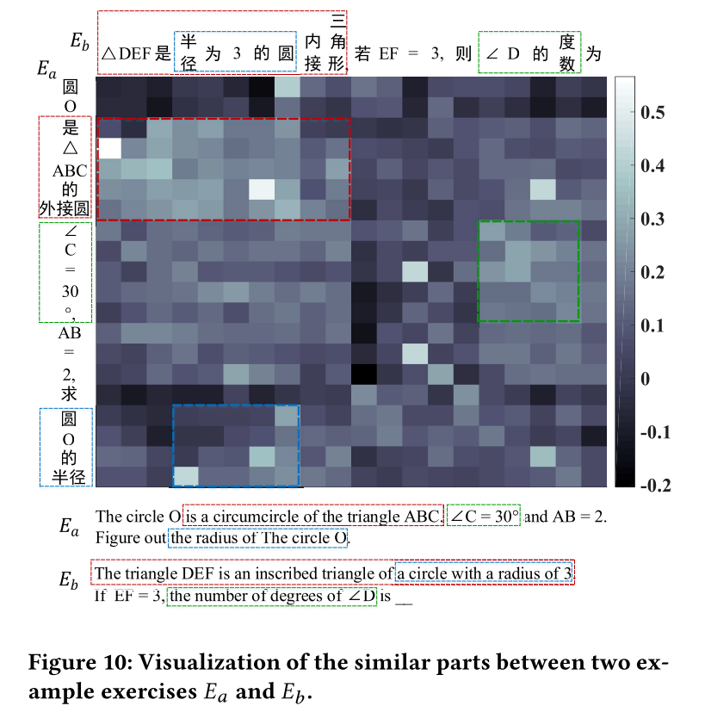
Experiments

Slide 25
4.
Conclusions

Slide 26
Conclusions
Novel Multimodal Attention-based Neural Network (MANN)
Integrate the multiple heterogeneous data.
Designed Attention-based LSTM network to learn a unified semantic representation.
With two attention strategies to find associations (TIA, TCA).
Designed a Similarity Attention to measure the similar parts.
Using pairwise training strategy to return similar exercises.

